Slide 1


Department of Computer Science and Engineering
REPRICE: SECOND-HAND LUXURY PRODUCT PRICE PREDICTION SYSTEM USING MACHINE LEARNING
Mrs. M. Divya M.E.
Assistant Professor
Sanjeevan Hari Sudhakar
2116220701251

Slide 2
Problem Statement and Motivation
Build a reliable system to automatically predict fair resale prices for second-hand luxury products.
With rising demand for sustainable fashion, there's a need for a reliable, automated pricing tool. A machine learning-based system can ensure fairness, boost seller confidence, and streamline the resale process with accurate, real-time price predictions.

Slide 3
Existing System
Current second-hand luxury pricing relies on manual estimates or rigid rule-based algorithms using fixed depreciation rates and brand tiers. These methods lack adaptability, ignore item-specific features, and are not trained on real data. Without machine learning or proper preprocessing, they produce inconsistent, biased prices. Most tools are backend-only, non-interactive, and offer poor user experience, making them unfit for scalable, modern resale platforms.

Slide 4
Objectives
The goal of “Reprice” is to build a machine learning-based system that predicts the resale value of second-hand luxury fashion items using features like brand, product name, condition, and original price. It uses OpenGridCV & Ridge Regression with a preprocessing pipeline to ensure accurate, consistent pricing. The system includes a React frontend and Flask backend for real-time, user-friendly predictions, aiming to reduce bias, improve transparency, and support the growing circular fashion economy.

Slide 5
Abstract
The second-hand luxury market is expanding rapidly, but fair pricing remains a challenge. To solve this, “Reprice” uses machine learning; specifically Ridge Regression—to predict resale prices based on brand, product, condition, and original price. Trained on the Vestiaire Fashion Dataset, the system uses a pipeline with encoding, scaling, and hyperparameter tuning (GridSearchCV) for accurate predictions. The model is deployed via a Flask API and React frontend for real-time user interaction.

Slide 6
Proposed System
The system uses Ridge Regression with GridSearchCV for accurate resale price prediction of luxury items. It processes data—brand, product name, condition, and price—from the Vestiaire Fashion Dataset via cleaning, encoding, and scaling. Rare categories are grouped to improve performance. Deployed with a Flask backend and ReactJS frontend, users can input details for real-time predictions. Future upgrades include image-based condition checks, currency conversion, and trend-based pricing for enhanced accuracy and sustainability.

Slide 7
System Architecture
The system architecture consists of four main components: the React frontend, Flask API backend, the Ridge Regression machine learning model, and the user. The user inputs product details through the React frontend, which sends a request to the Flask backend. The backend preprocesses the data, loads the trained ML model, and predicts the resale price. The result is then sent back to the frontend and displayed to the user. This modular structure ensures efficient processing and scalability.

Slide 8
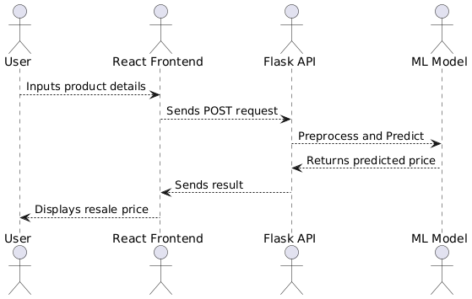
System Architecture

Slide 9
List of Modules
Data Preprocessing
Handling Missing Data
Feature Transformation and Encoding
Price Normalization
Price Prediction Using Ridge Regression
Train-test Split
Model Training and Tuning
Model Exporting

Slide 10
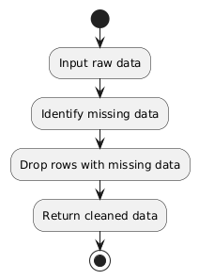
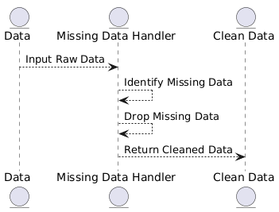
Handling Missing Data (Data Preprocessing)
Missing rows were dropped to ensure clean and complete inputs.

Slide 11
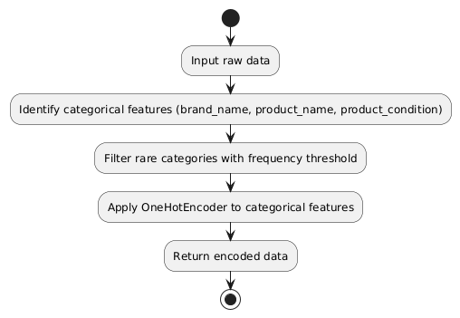
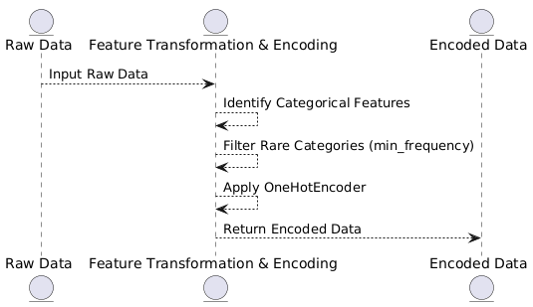
Feature Transformation and Encoding (Data Preprocessing)
Categorical features (brand_name, product_name, product_condition) were encoded using OneHotEncoder with a minimum frequency threshold to avoid sparse matrix issues.

Slide 12
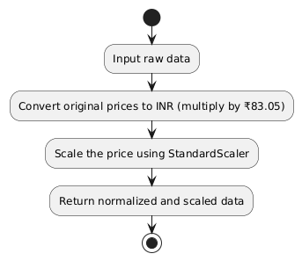
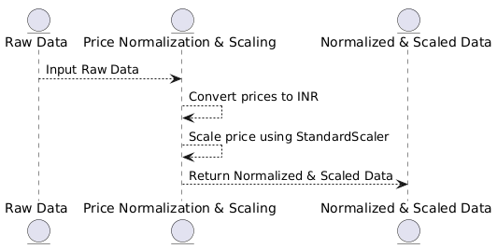
Price Normalization (Data Preprocessing)
Original prices in USD were multiplied by ₹83.05 to obtain INR equivalents for both original and resale prices. The price features were scaled using StandardScaler to standardize inputs for the regression model.

Slide 13
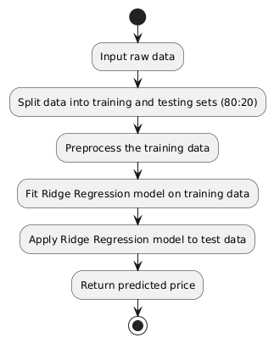
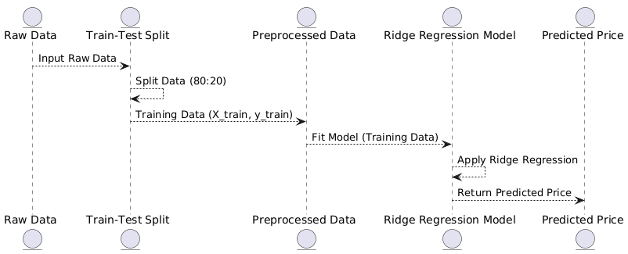
Train-test Split (Price Prediction)
The dataset was split into training and testing sets using an 80:20 ratio. Training data was used to fit the model, and testing data was used to evaluate generalization performance.

Slide 14
Model Training and Tuning (Price Prediction)
The machine learning pipeline included a ColumnTransformer for preprocessing and a Ridge Regression model as the estimator. GridSearchCV was used to optimize the alpha parameter. Evaluation metrics such as Mean Squared Error (MSE) and R² Score were used to assess performance.

Slide 15
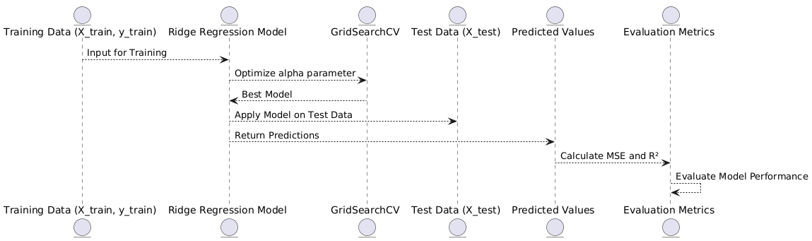
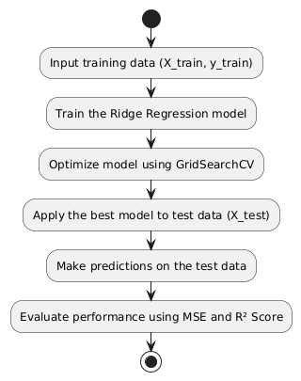
Model Training and Tuning (Price Prediction)

Slide 16
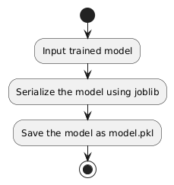
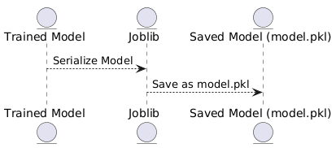
Model Exporting (Price Prediction)
The trained model was serialized using joblib and saved as model.pkl to be used during inference by the backend.

Slide 17
Implementation & Results of Module
Comprehensive testing ensured model accuracy and system stability. The backend was tested with multiple inputs for reliable predictions, while the frontend was validated for form handling, error management, and responsiveness. Integration testing confirmed consistent data flow and output generation. The system predicted resale prices with an accuracy of up to 0.996.

Slide 18
Implementation & Results of Module
The "Luxury Item Resale Price Predictor" platform offers a user-friendly interface for estimating resale values of luxury items. Users input product details such as brand, name, condition, and original price, and the backend powered by a Ridge Regression model provides a predicted resale price in INR. The platform promotes fair pricing and transparency in the second-hand luxury market.

Slide 19
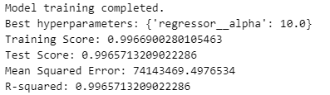
Implementation & Results of Module

Slide 20
Conclusion & Future Work
Reprice uses Ridge Regression and GridSearchCV to estimate resale prices for second-hand luxury fashion products with high accuracy. The system integrates a preprocessing pipeline for handling high-cardinality categorical variables, scaling numerical features, and optimizing model performance. It achieves a low mean squared error (0.996) and good predictive accuracy on the test dataset.

Slide 21
Conclusion & Future Work
Future improvements may include image-based condition analysis, real-time currency conversion, and incorporating user behavior data to further refine predictions. Docker containerization and model versioning will help scale the system for production use.

Slide 22
References
[1] X. Fan, J. Wang, et al., “Price prediction in e-commerce using ensemble learning methods: A case study on online retail platforms,” International Journal of Data Science and Analytics, vol. 10, no. 2, pp. 125–136, 2023.
[2] L. Zhou, et al., “A hybrid Ridge and Lasso regression framework for pricing second-hand electronics,” Journal of Applied Artificial Intelligence, vol. 36, no. 7, pp. 642–658, 2022.
[3] A. Chauhan and S. Sharma, “Effective preprocessing for price estimation using OneHotEncoding and normalization,” Procedia Computer Science, vol. 183, pp. 910–918, 2021.
[4] A. Kulkarni and R. Gupta, “Regression-based price optimization for fashion resale platforms,” Journal of Fashion Technology & Textile Engineering, vol. 12, no. 1, pp. 34–41, 2022.

Slide 23
Paper Publication Status
Yet to publish.

Slide 24
Thank You

